Slide 1
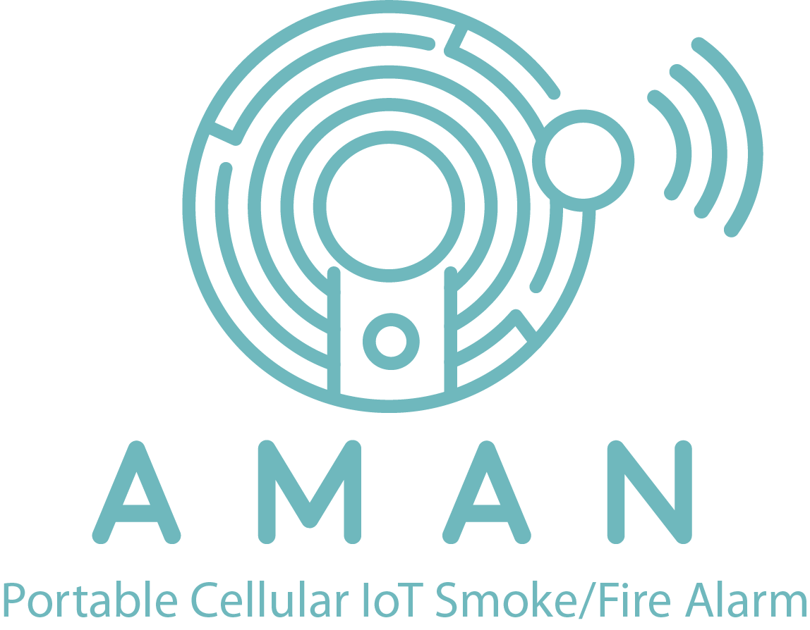
AMAN - أمان
Portable Cellular-IoT Smoke / Fire Alarm for Public Safety
10/17/22
Team members: Amna Al-Haddad, Rashid Al-Mohannadi, and Maryam Al-Khater
Mentor: Dr. Hussein Alnuweiri
Instructor: Dr. Joseph Boutros

Slide 2
Introduction / Motivation
Problem Statement / Aim Of Project
Proposed Solution
OUTLINE
Standards
Literature Review
Functional Model
Code & Results
Progress Timeline
Conclusion

Slide 3
INTRODUCTION
Increasing amount of recorded fires according to CTIF [1]
Remote areas don’t have basic safety needs: 11 workers died in remote area 100km away from Doha [2]
AMAN
In California (USA), a food truck explosion caused two minor injuries [3]
New technologies rely on batteries and electricity are a factor in increased fire
See references in slide 15
2

Slide 4
PROBLEM STATEMENT
Remote areas without connected power have no fire safety. This device ensures the safety of people and property to reduce fire risks and response times.
Notes:
Need to adjust to be a problem statement

Slide 5
START
PROPOSED SOLUTION
To create a smart/ wireless fire alarm that works on a NB-IoT and has its own power supply. The device would detect fire in locations and send a signal to the manager or fire responders through a cellular connection.
Wait for NB-IOT to connect to the network
Check Sensor Data & Update Values
The device will be a be able to connect to local networks to alarm the user if fire is detected
NO
Fire Detected
No need to supply wired connection to the device as it works via power supply
YES
Start the Buzzer Alarm & Alert the User Via IOT
Figure 1

Slide 6
PROPOSED SOLUTION (CONT’D)
Buzzer
Rechargeable Battery
MQ2 Smoke /
Gas Sensor
Controller Unit: Arduino Uno Rev3
NB loT Device
loT Cloud
Smart Device
Flame Sensor
Block Diagram
Notes:
Put flow chart and block diagram

Slide 7
STANDARDS
IEEE 1573-2003[4]: Electronic Power Subsystems
UL60950[5]:
Information Technology Safety
EN14604[6]:
Sound Output
EN14604[6]:
Battery life
IEC 60335-1[4]:
Safety of Electrical Equipment
See references in slide 15

Slide 8
LITERATURE REVIEW
 | Normal Hardwired Fire/Smoke Detector Alarm | AMAN Fire/Smoke Detector alarm
Installation mode | Complex Process | Simple
Installation cost | High | Low
Installation time | More | Less
Modification | Hard | Flexible
Maintenance mode | Need Technician | Programming system
Maintenance cost | High | Low
Signal interference | Not required | Required
Server | - | IoT Cloud
Source | Power supply | Battery Powered
Budget | Low | High
Mobile message alert | Not supported | Supported
Alarm | Supported
Sensors | Smoke/Gas/Flame
Software Platform | - | Have

Slide 9
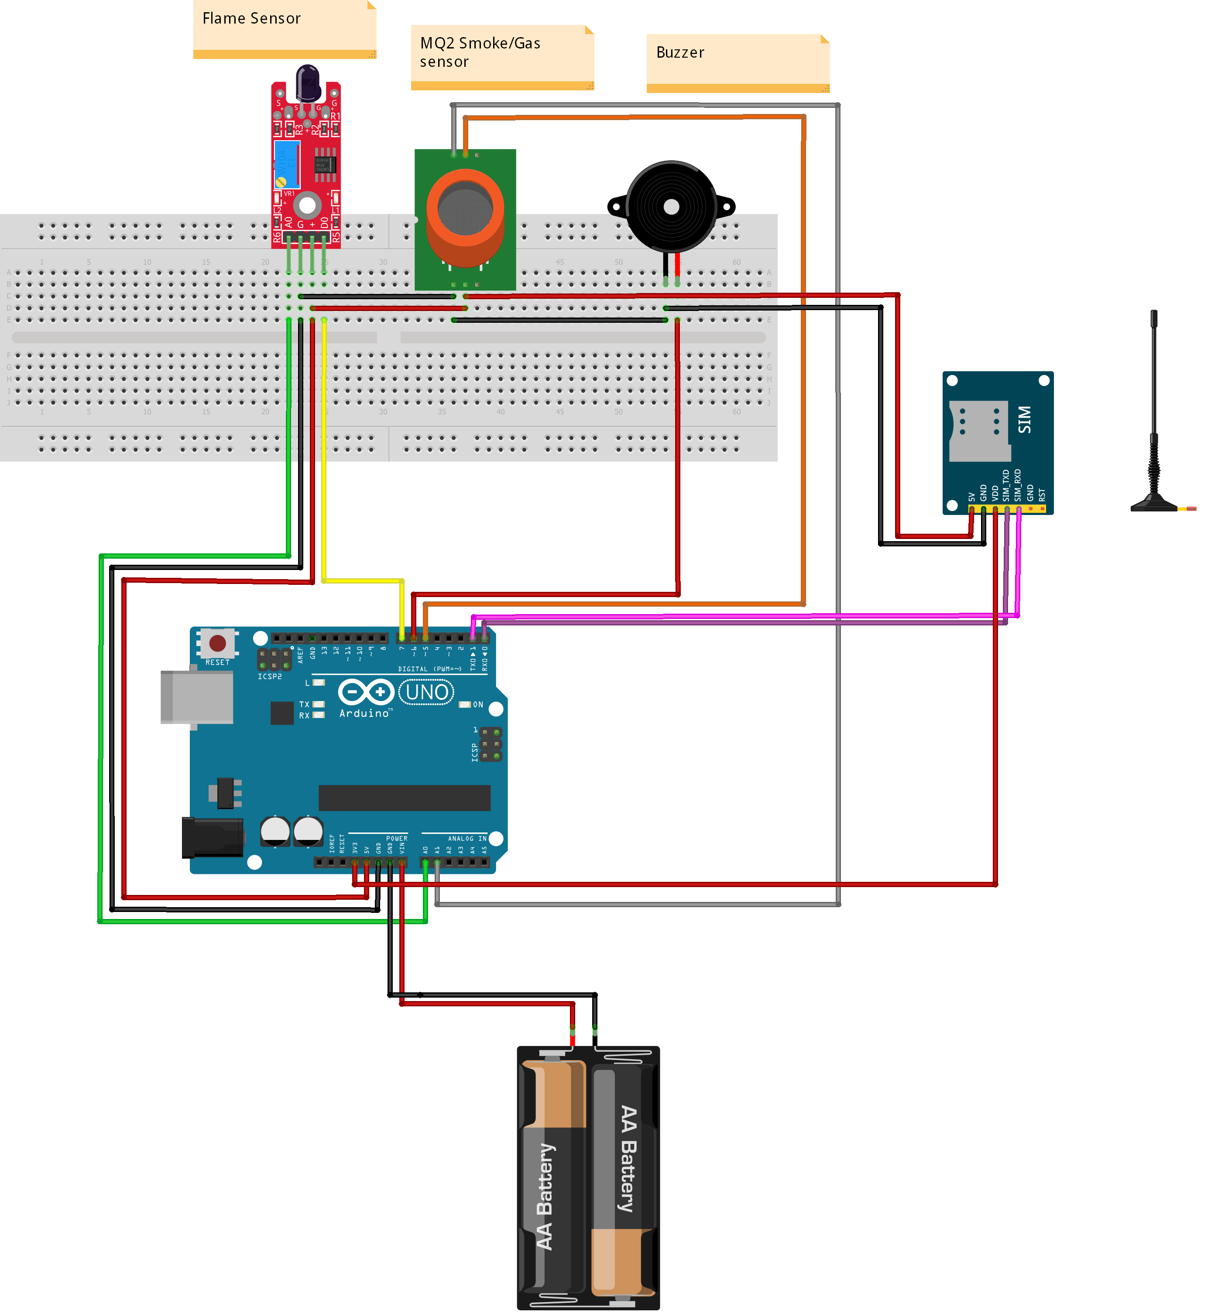
Flame Sensor
MQ2 Sensor
Buzzer
FUNCTIONAL MODEL
SIM NB-IoT
01
Sensors, Narrow-Band IoT, Alarm (Buzzer), Battery case are all connected to Arduino MCU.
02
Flame Sensor reacts with 760 - 1100 nm wavelength range.
Arduino
03
Gas Sensor detects gases at range of 200 - 10000 ppm.
04
Device powered by a rechargeable battery.
Rechargeable Baterry
Figure 2

Slide 10
CODE
Initialize the Library
RANGE CALCULATION
$$10bit \left(ADC\right)→2^{10}→1024$$
$$\frac{1024}{5}=204.8$$
$$Flame Sensor detect above 675:$$
$$204.8×3.3=675$$
$$MQ2 Sensor detect below 300:$$
$$\frac{5}{1024}=0.0048$$
$$0.0048×300=1.44$$
$$300 CUTOFF$$
Set the connection with sensors
Calibrating the ranges for the sensors
Test the range & collect data
NO
Fire Detected
YES
Start the Buzzer Alarm & Alert the User Via IOT
Figure 3

Slide 11
RESULT
NOT DETECTED
ONE SENSOR DETECTED
BOTH SENSORS DETECTED
ONE SENSOR DETECTED
Figure 4

Slide 12
BUDGET
FLAME SENSOR
GAS SENSOR
ARDUINO MCU
NB IOT
JUSTIFICATION:
JUSTIFICATION:
JUSTIFICATION:
JUSTIFICATION:
Detect and react when a fire or flame occurs
Detect and classify several gases
Collect data from the sensors
Connects devices to an extensive array of IoT devices and services.
$7.60
$7.60
$26.79
$42.99
ALARM
BATTERY
BATTERY CASE
TOTAL COST
JUSTIFICATION:
JUSTIFICATION
JUSTIFICATION:
Alert people close to the fire location
Supply power to device
To connect 2 AA batteries in a dedicated place
$82.45
$1.60
$1.04
$2.20
1 USD = 3.64 QAR

Slide 13
PROGRESS TIMELINE
Task | Progress | Start | End | Month | AUG |  |  |  | SEP |  |  |  | OCT |  |  |  | NOV
 |  |  |  | week | 1 | 2 | 3 | 4 | 1 | 2 | 3 | 4 | 1 | 2 | 3 | 4 | 1 | 2 | 3 | 4
Team Formation | 100% | 8/1/22 | 8/3/22
Project Planning #1 | 100% | 8/4/22 | 8/7/22
Project Planning #2 | 100% | 8/8/22 | 8/14/22
Bill of Materials | 100% | 8/10/22 | 8/20/22
ConOps Project Report | 100% | 8/15/22 | 8/20/22
Presentation | 100% | 8/22/22 | 9/5/22
ConOps update | 100% | 8/31/22 | 9/3/22
FSR,ICD, Milestones and validation plan | 100% | 9/12/22 | 9/19/22
Arduino programming | 100% | 9/1/22 | 9/28/22
Project update Presentation | 50% | 9/20/22 | 10/3/22
Assemble Prototype | 50% | 10/1/22 | 10/20/22
Update all drafts | 50% | 10/10/22 | 11/1/22
Design 3D cover for AMAN | 00% | 10/8/22 | 10/22/22
Prepare Video Ad for AMAN | 50% | 10/8/22 | 10/22/22
Project subsystem Demonstrations | 50% | 10/10/22 | 10/31/22
Final Presentation | 33% | 9/1/22 | 10/24/22
Final Report | 10% | 10/16/22 | 11/7/22
TIMELINE KEYS
Not started
Complete
In progress

Slide 14
STAGE 1
STAGES
STAGE 2
Interfacing The Sensors With Arduino
Communication
STAGE 1.1
Flame Sensor + Buzzer
STAGE 1.2
Smoke Sensor

Slide 15
CONCLUSION
WHAT?
WHY?
HOW?
Increase in the number of fires globally
To resolve fire safety in remote areas without access to connected power and communication
Developing a portable cellular IoT fire/smoke alarm to ensure safety in public locations without access to hardwired fire alarms

Slide 16
REFERENCES
01
World Fire Statistics. (n.d.). World Fire Statistics | CTIF - International Association of Fire Services for Safer Citizens through Skilled Firefighters. https://ctif.org/world-fire-statistics
Khatri, S. S. (2016, June 5). Questions about labor camp safety raised after deadly Qatar fire. Doha News | Qatar. From https://dohanews.co/questions-labor-camp-safety-raised-deadly-qatar-fire/
02
AMAN
Harrington, J. (2022, June 28). ABC30 News - KFSN Fresno and Central Valley News and Weather. From https://abc30.com/amp/planet-vegan-fresno-food-truck-fire-explosion/11999243/
03
04
IEEE SA - IEEE 1573-2003. (n.d.). IEEE Standards Association. From https://standards.ieee.org/ieee/1573/2311/
05
Systems. (n.d.). Www.purcellsystems.com. From https://www.purcellsystems.com/ul-60950-1-standard/
What is EN14604 Standard for Wireless Smoke Detector - Key Security. (n.d.). Www.keysecurity.com.tw. From https://www.keysecurity.com.tw/EN14604-standard-wireless-smoke-detector.html?lang=en
06
15

Slide 17
THANK YOU
FOR YOUR ATTENTION !
ANY QUESTION ?

