Slide 1



AMAN - أمان
Portable Cellular Smoke / Fire Alarm for Public Safety
20/04/2023
Mentor: Dr. Hussein Al-Nuweiri
Team Member: Amna Al-Haddad, Rashid Al-Mohannadi and Maryam Al-Khater
Instructor: Dr. Joseph Boutros

Slide 2
Introduction / Motivation
Problem Statement / Aim Of Project
Proposed Solution
OUTLINE
Standards
Literature Review
Functional Model
Code & Results
Future Development
Conclusion

Slide 3





INTRODUCTION
Increasing amount of recorded fires according to the association of fire and rescue services (CTIF) [1]
Remote areas don’t have basic safety needs: 11 workers died in remote area 100km away from Doha [2]
AMAN
In California (USA), a food truck explosion caused two minor injuries [3]
New technologies rely on batteries and electricity are a factor in increased fire
See references in slide 15
2

Slide 4



PROBLEM STATEMENT
Remote areas without connected power have no fire safety. This device ensures the safety of people and property to reduce fire risks and response times.
Notes:
Need to adjust to be a problem statement

Slide 5


START
PROPOSED SOLUTION
To create a smart/cellular fire alarm that works on cellular and has its own power supply. The device would detect fire in locations and send a signal to the manager or fire responders through a network connection.
Wait for Micro controller unit (MCU) to connect to GSM and server
Check Sensor Data & Update Values
The device will be a be able to connect to local networks to alarm the user if fire is detected
Reset
NO
Fire Detected
No need to supply wired connection to the device as it works via power supply
YES
Start the Buzzer Alarm & Alert the User
Figure 1: device flow chart

Slide 6




PROPOSED SOLUTION (CONT’D)
Buzzer
Rechargeable Battery
Controller Unit: Arduino Uno Rev3
MQ2 Smoke /
Gas Sensor
GSM SIM 900
loT(internet of things) Cloud
Smart Device
Flame Sensor
Block Diagram 1: Shows diagram of a Complete device
Notes:
Put flow chart and block diagram

Slide 7



STANDARDS
IEEE 1573-2003[4]: Electronic Power Subsystems
UL60950[5]:
Information Technology Safety
EN14604[6]:
Sound Output
IEC 60335-1[4]:
Safety of Electrical Equipment
See references in slide 15

Slide 8
LITERATURE REVIEW
 | Hardwired Fire/Smoke Alarm | Our Device
Installation mode | Complex Process | Simple
Installation cost / time | High / More | Low / Less
Modification | Hard | Flexible
Maintenance cost | High | Low
Cellular network | Not required | Required
Source | Power supply | Battery Powered
Mobile message alert | Not supported | Supported
Alarm | Supported | Supported
Price | Low | High
Sensors | Smoke/Gas/Flame | Smoke/Gas/Flame
Software Platform | Not Supported | Supported

Slide 9
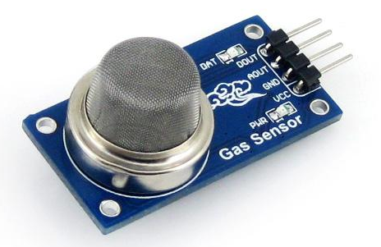
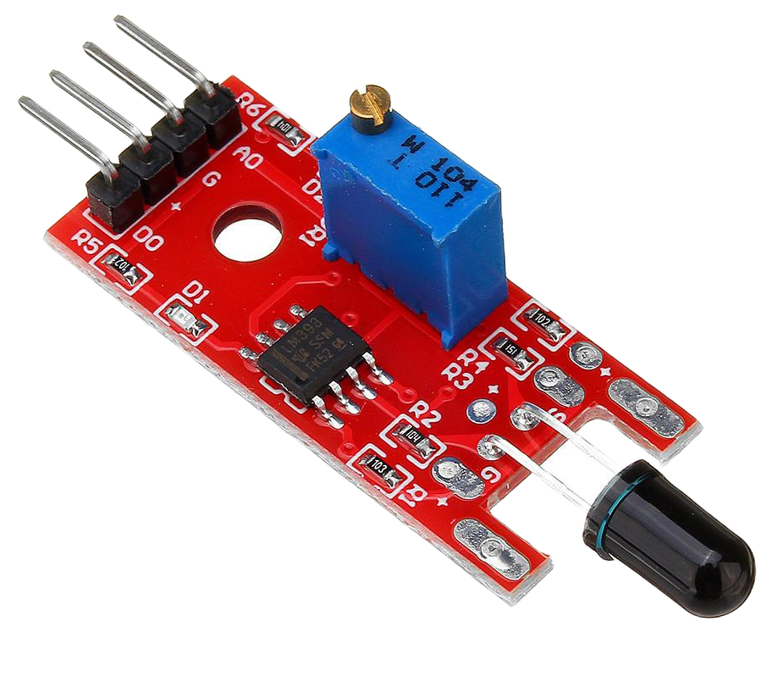
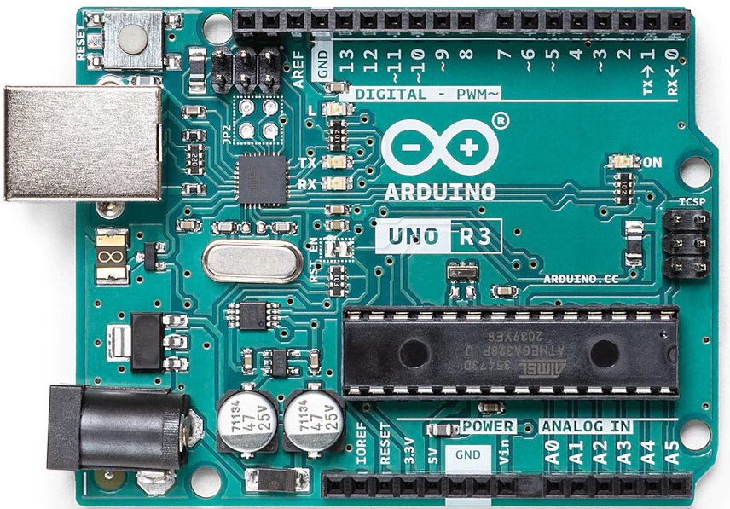
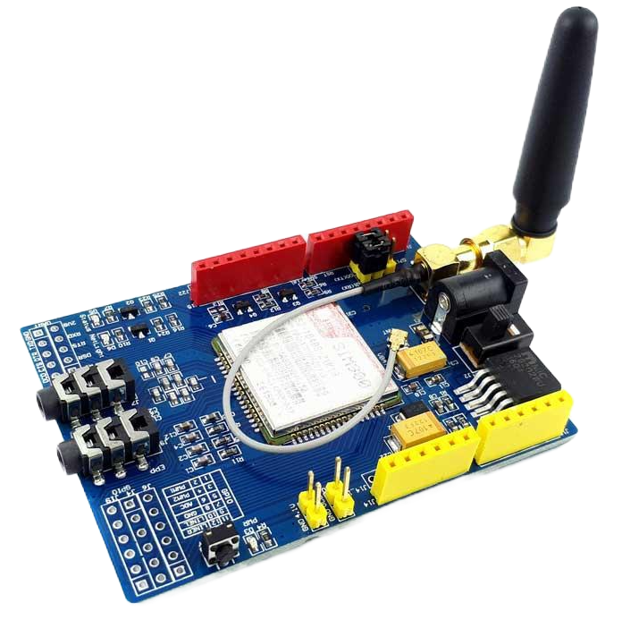
SPECIFICATION
Metal Oxide Semiconductor (MQ2) Sensor:
Detection gas: LPG, Smoke, Alcohol, Propane, Hydrogen, Methane and Carbon Monoxide
Concentrations: 200 to 10000 ppm
Arduino Uno Rev3:
Operating voltage : 5V
Advantages:
Inexpensive Hardware
Tons of Libraries
Cross Platform Support
21 mm
26 mm
Figure 3: MQ2
27.3 mm
Flame Sensor:
Spectrum range: 760nm ~ 1100nm
15.4 mm
Figure 4: Flame Sensor
53.4 mm
SIM900 GSM Shield for Arduino :
Supply Voltage: 3.2-4.8V
Send & receive SMS messages & GPRS data
71 mm
66 mm
Figure 2: Arduino Uno R3
68.6 mm
Figure 5: SIM900

Slide 10
BUDGET
FLAME SENSOR
GAS SENSOR
SIM900 GSM Shield for Arduino
JUSTIFICATION:
JUSTIFICATION:
JUSTIFICATION:
Detect and react when a fire or flame occurs
Detect and classify several gases
Used for GSM communication
$2.47
$5.22
$ 21.70
$42.99
ALARM
BATTERY
ARDUINO UNO R3
TOTAL COST
JUSTIFICATION:
JUSTIFICATION
JUSTIFICATION:
Alert people close to the fire location
Supply power to device
Collect data from the sensors
$44.39
$1.60
$1.04
$ 12.36
1 USD = 3.65 QAR

Slide 11
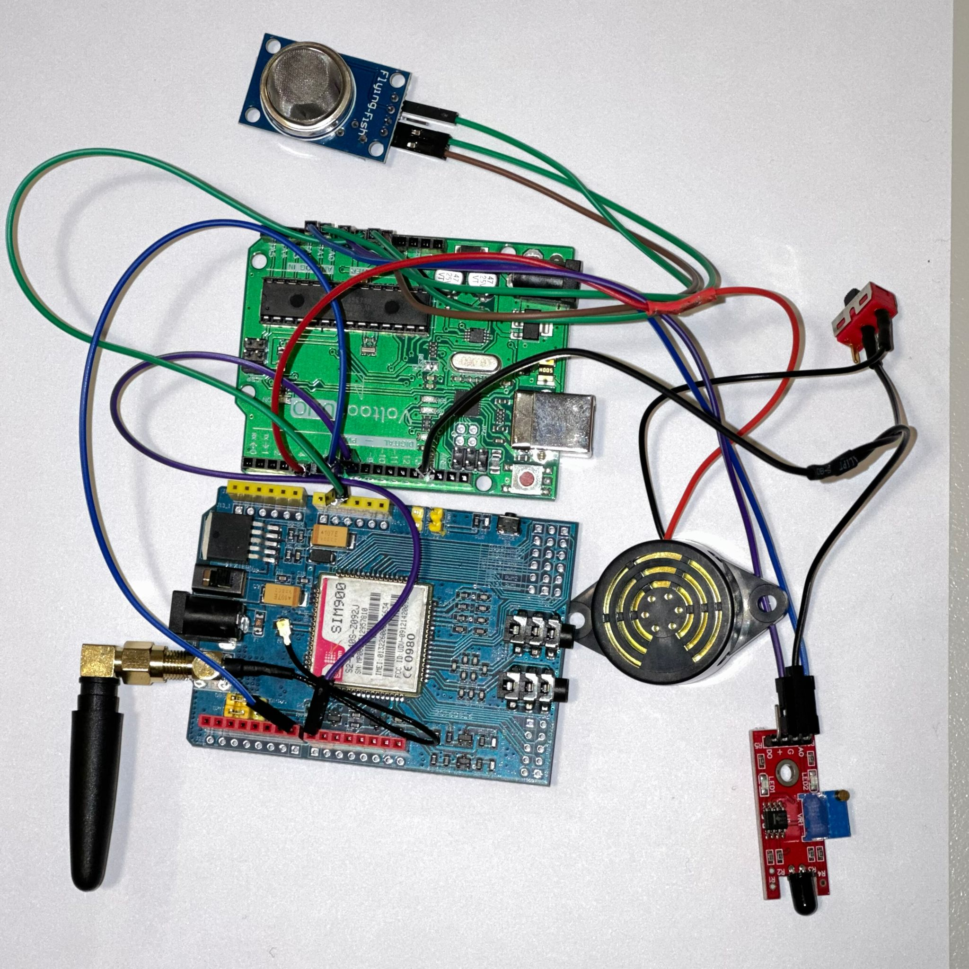
FUNCTIONAL MODEL
Battery
Buzzer
SIM900 GSM
Flame Sensor
MQ2 Sensor
Arduino
Figure 6: Schematic circuit design of AMAN
Figure 7: Prototype of circuit design of AMAN
Notes:
Add slide of specifaction
Also add temperature and humidty ..

Slide 12
CODE
Initialize the Library
Set the connection with sensors
Collect and Compare Data
NO
Fire detected
Send Data to Thingspeak (IoT Cloud)
Yes
User Alerted via
SMS & Call
Figure 7: Code flow chart

Slide 13
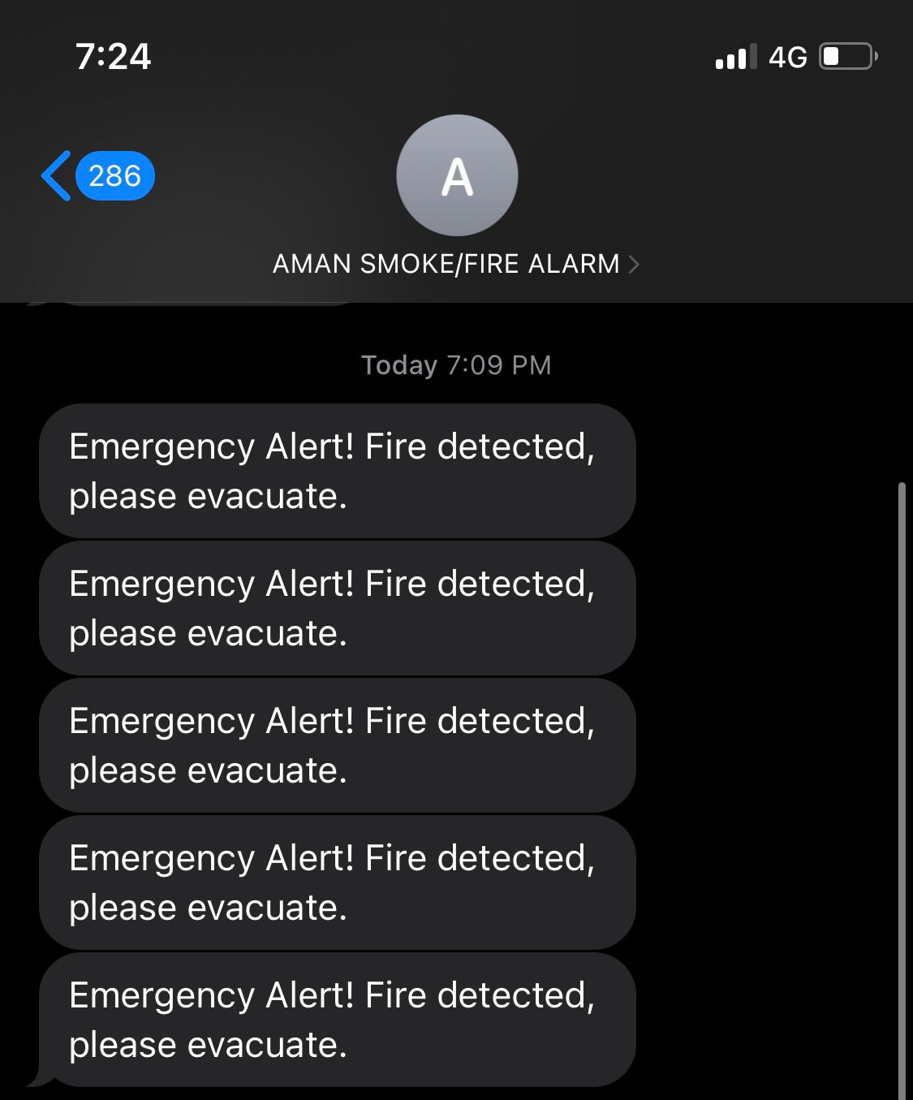
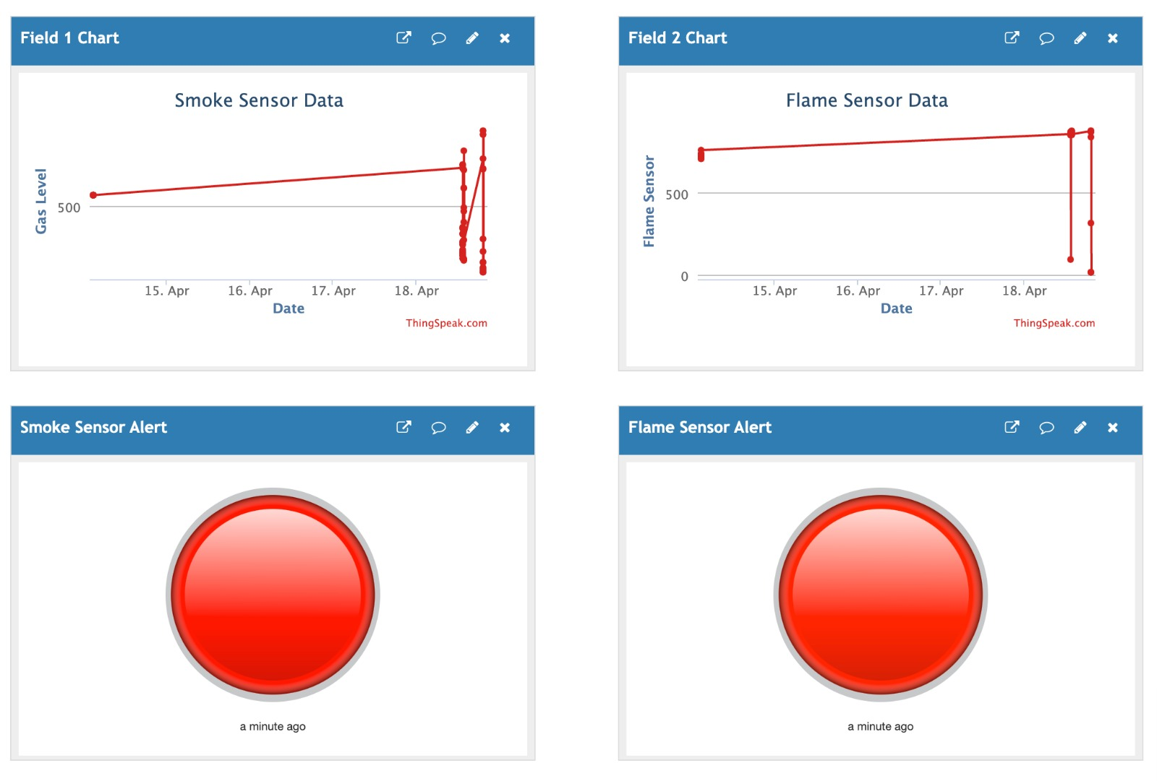
RESULTS
Figure 8: Data of the sensor collected from Server
Figure 9: SMS Message

Slide 14



FUTURE DEVELOPMENT
Monitor System
Create a mobile Application

Slide 15



CONCLUSION
WHAT?
WHY?
HOW?
Increase in the number of fires globally
To resolve fire safety in remote areas without access to connected power and communication
Developing a portable cellular fire/smoke alarm to ensure safety in public locations without access to hardwired fire alarms

Slide 16

REFERENCES
01
World Fire Statistics. (n.d.). World Fire Statistics | CTIF - International Association of Fire Services for Safer Citizens through Skilled Firefighters. https://ctif.org/world-fire-statistics
02
Khatri, S. S. (2016, June 5). Questions about labor camp safety raised after deadly Qatar fire. Doha News | Qatar. From https://dohanews.co/questions-labor-camp-safety-raised-deadly-qatar-fire/
AMAN
Harrington, J. (2022, June 28). ABC30 News - KFSN Fresno and Central Valley News and Weather. From https://abc30.com/amp/planet-vegan-fresno-food-truck-fire-explosion/11999243/
03
04
IEEE SA - IEEE 1573-2003. (n.d.). IEEE Standards Association. From https://standards.ieee.org/ieee/1573/2311/
05
Systems. (n.d.). Www.purcellsystems.com. From https://www.purcellsystems.com/ul-60950-1-standard/
What is EN14604 Standard for Wireless Smoke Detector - Key Security. (n.d.). Www.keysecurity.com.tw. From https://www.keysecurity.com.tw/EN14604-standard-wireless-smoke-detector.html?lang=en
06
15

Slide 17

THANK YOU
FOR YOUR ATTENTION !
ANY QUESTION ?

